Slide 1
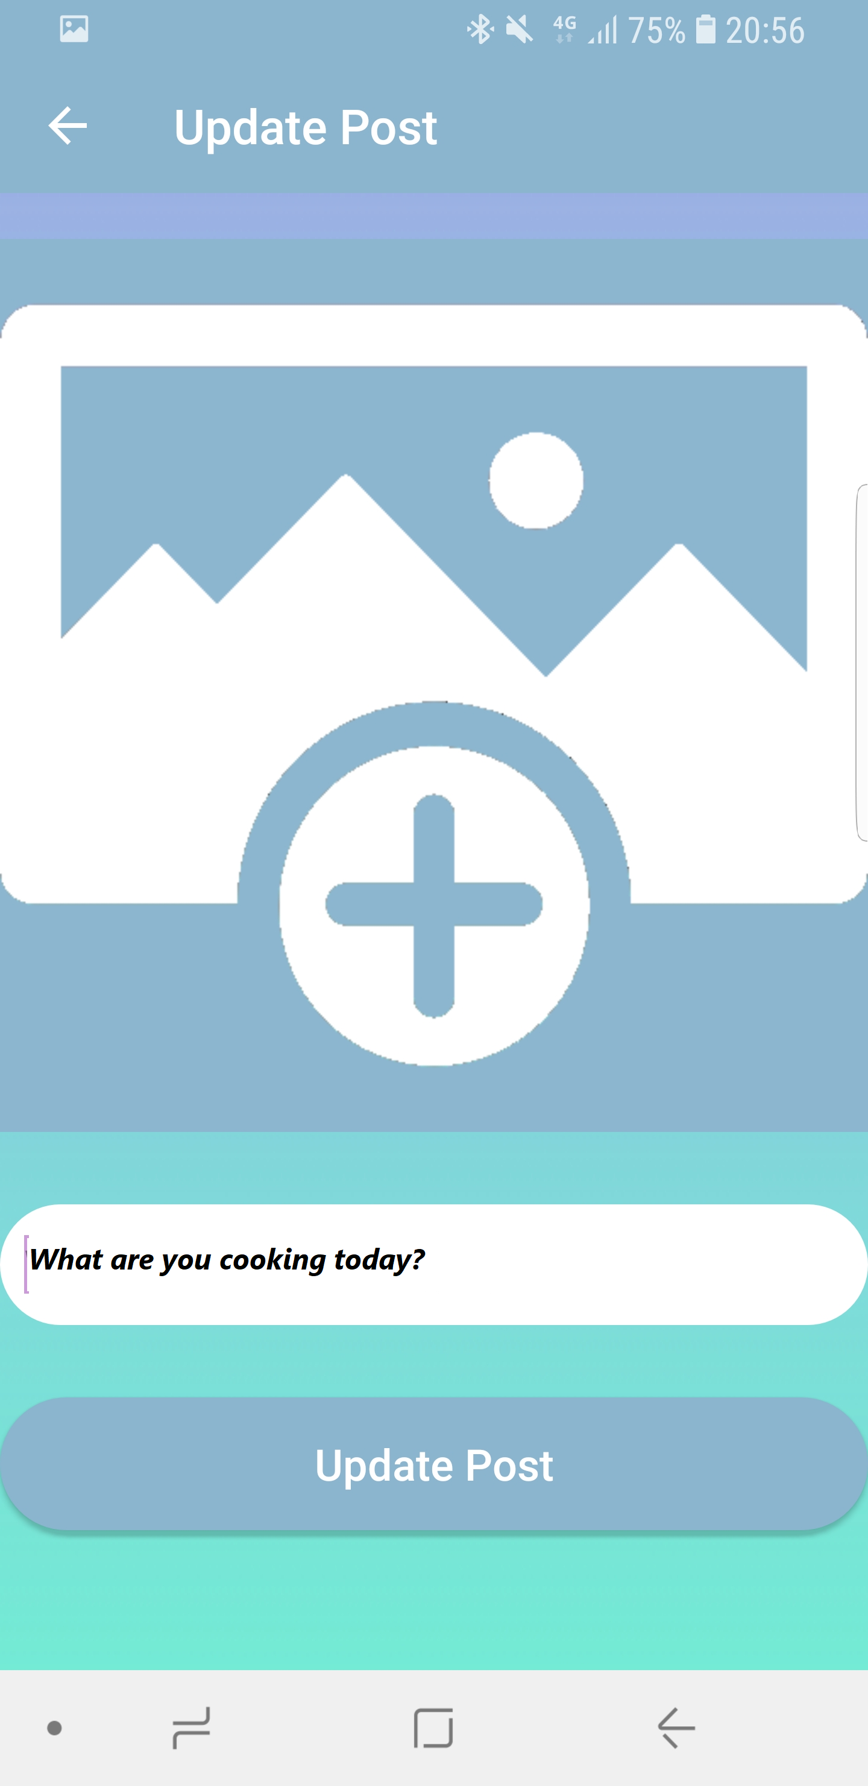
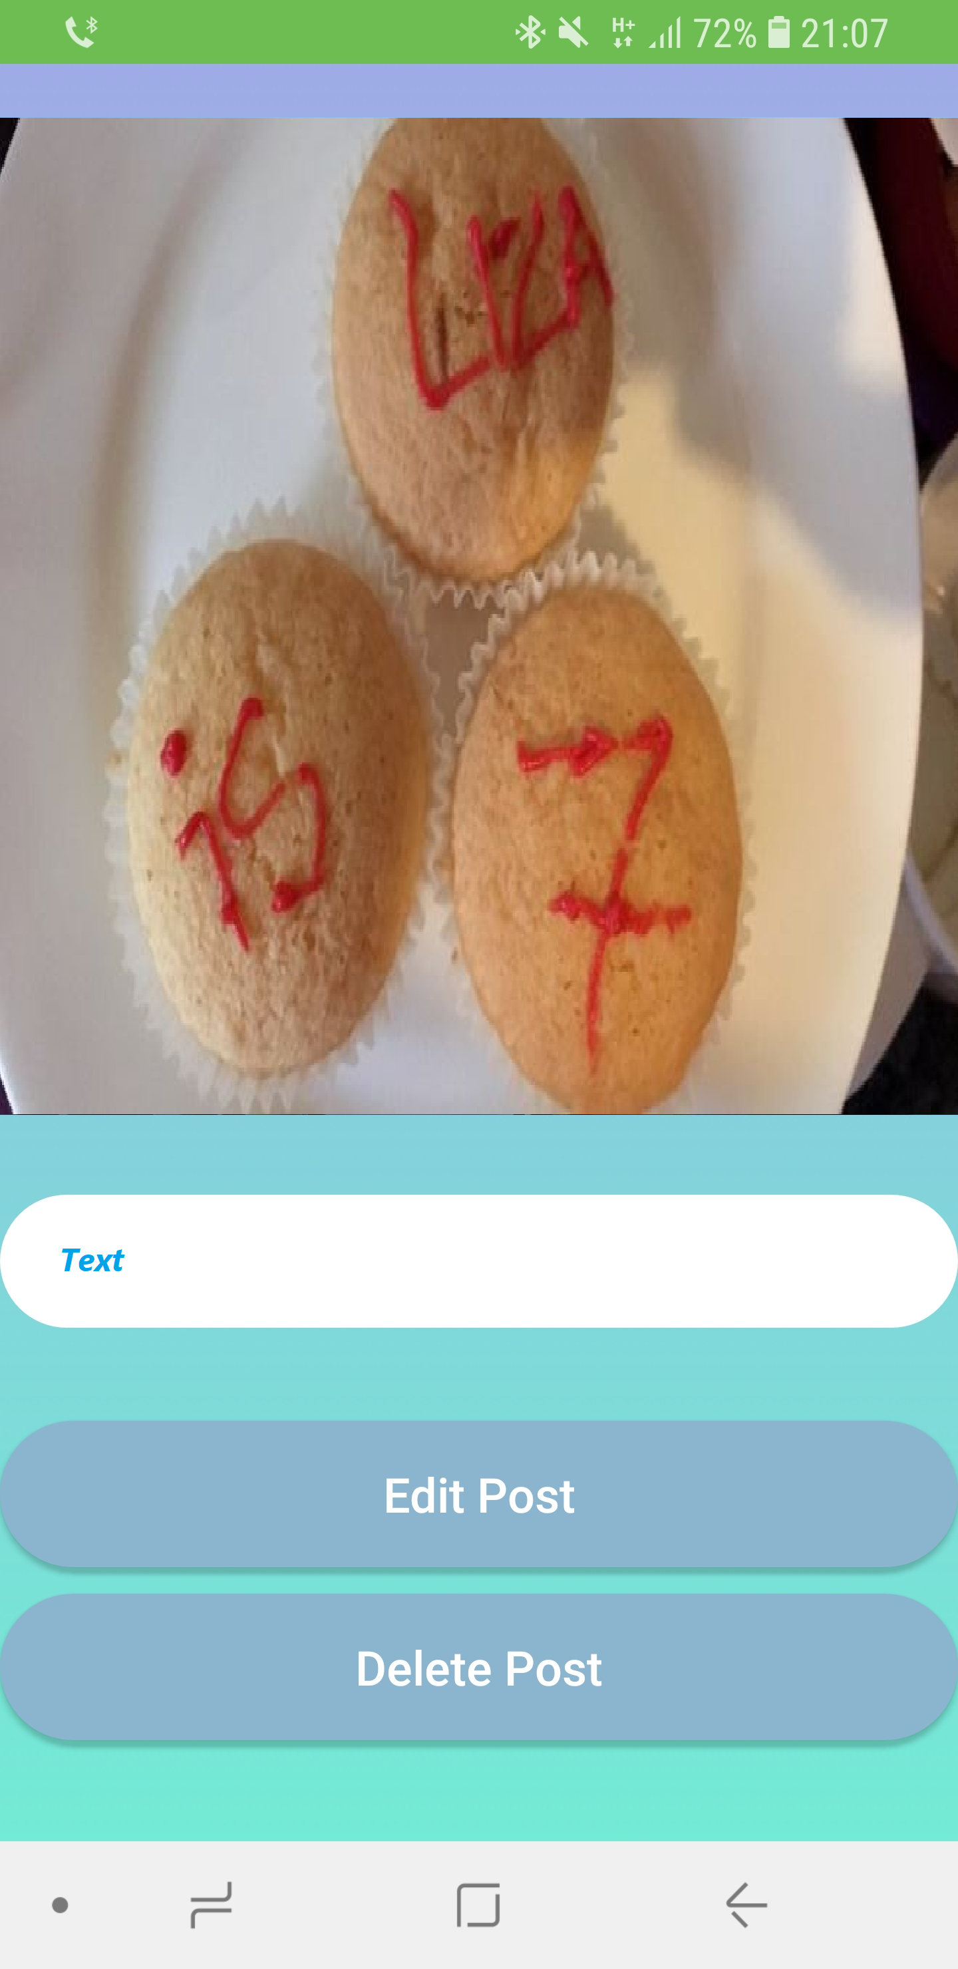
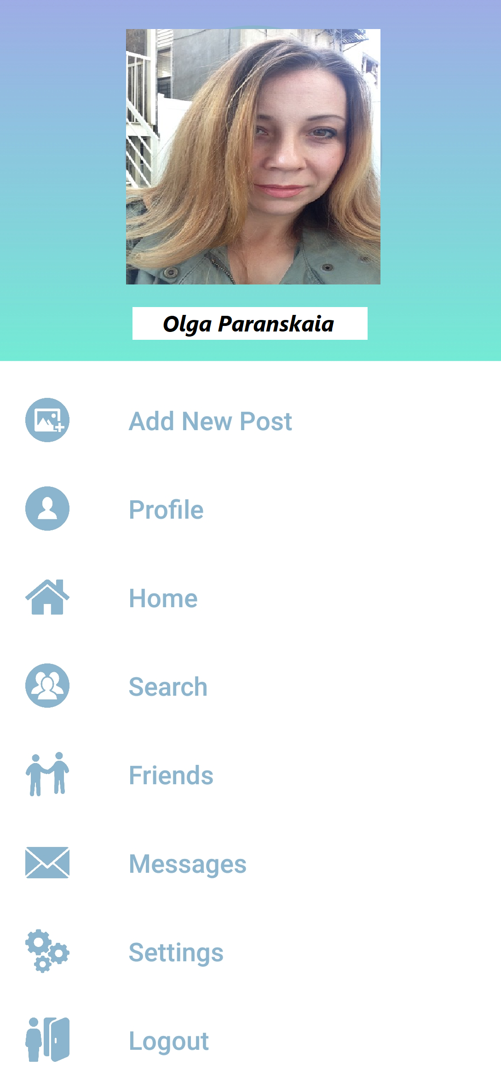
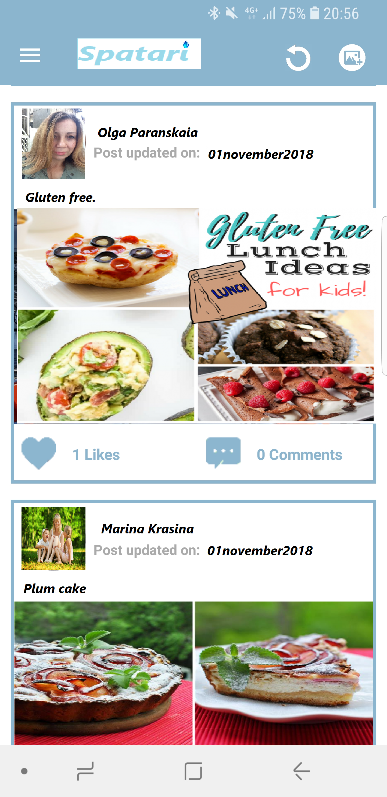
Mobile APP Spatari
Proper nutrition for special children
Selection of the daily diet for autistic children to change the intestinal microbiota in order to correct the symptoms of the disease.

Slide 2
About
Selection of the daily diet for autistic children to change the intestinal microbiota in order to correct the symptoms of the disease.
Children with ASD have a lower number of enzymatic bacteria (for example, Prevotella copri), as well as lower overall bacterial diversity, and it has been suggested that the lack of a beneficial intestinal microbiota impairs neurological health. In accordance with the experimental data, it was shown that an increase only with the help of Bacteroides fragilis can lead to changes in the intestinal microbiota and blood metabolite profiles, correct the increased intestinal permeability (gaps in the cross between cells) and improve the behavior associated with ASD.
The right mix of gut microbes relieves symptoms in the long run.

Slide 3
Data analysis
Microbiota Transfer Therapy (MTT) on the composition of the intestinal microbiota and GI and ASD symptoms in 18 children diagnosed with ASD
Microbiota transfer alters gut ecosystem and improves gastrointestinal and autism symptoms. Kang, D, Adams, JB, Gregory, A, Borody, T, Chittick, L, Fasano, A, Khoruts, A, Geis, E, Maldonado, J, McDonough-Means, S, Pollard, EL, Roux, S, Sadowsky, MJ, Lipson, KS, Sullivan, MB, Caporaso, JG, and Krajmalnik-Brown, R. Microbiome.
AWS data, including the Human Microbiome Project

Slide 4
Mobile app functionality «spatari»
Personal account: personal data entry and personal recommendations
Calender of observations of the dynamics of change
Recommendations on cooking (recipes, videos)
Chat bot
Social network for parents of children
Prepared food complexes, order, delivery
Order of non-medicinal biologically active drugs

Slide 5










Resources

Slide 6
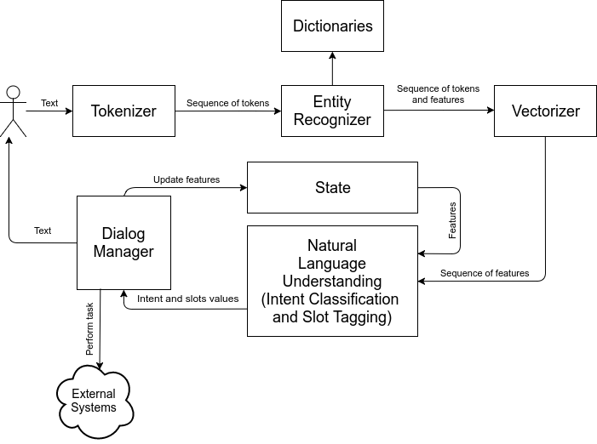
Chat-bot architecture with natural language processing

Slide 7
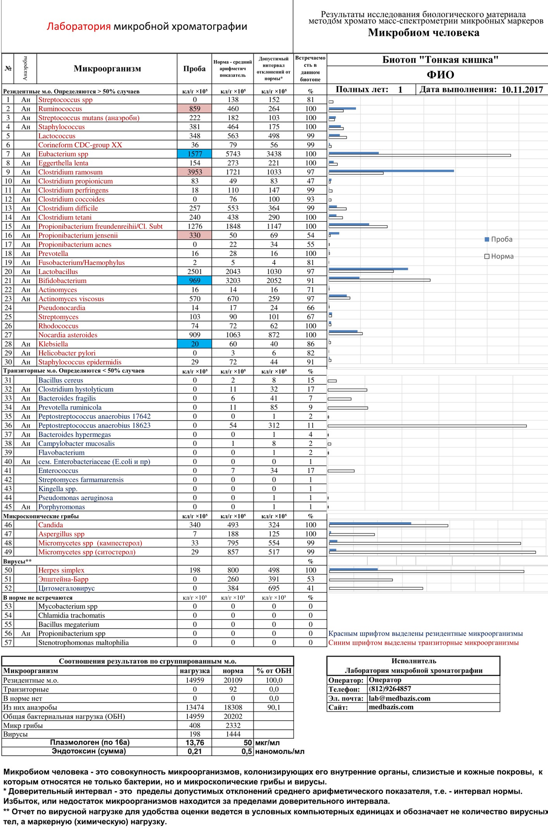
Microbial Marker Chromato-Mass Spectrometry Technique
Food recommendation
Сooking recipes

Slide 8

Social network «Spatari»

Slide 9
Project revenue
Advertising: push notifications; ads icons; pop-up ads; offers; videos
Built-in purchases or subscriptions: ready-made foods; non-drug additives, ready-made food complexes;
Sales Services: Therapists, Autism Specialists, Group Lessons and Seminars

Slide 10
Spatari Inc
Olga Paranskaia
Cell: +1(347)419-1998
E-mail: olgaparanskaia@gmail.com
US, New York, New York,

